Slide 1
Secure Systems Engineering
Chester Rebeiro
Indian Institute of Technology Madras
Notes:
An analogy
Flaws in the box
Human
Programming Bugs
Human Causes
Programming Bugs
Eg. A buffer overflow
Countermeasures
Prevention
Better programming languages
Better libraries
Formal verification
Hardware improvements
Can’t prevent; so make it difficult

Slide 2
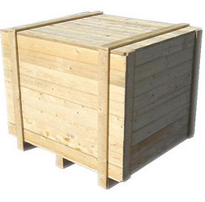
Secure Systems
Computer systems can be considered a closed box.
Information in the box is safe as long as nothing enters or leaves the box.

Slide 3



Systems Still Secure
Even with viruses, worms, and spyware around information is still safe as long as they do not enter the system

Slide 4
Vulnerability
A flaw that an attacker can use to gain access into the system
flaw

Slide 5


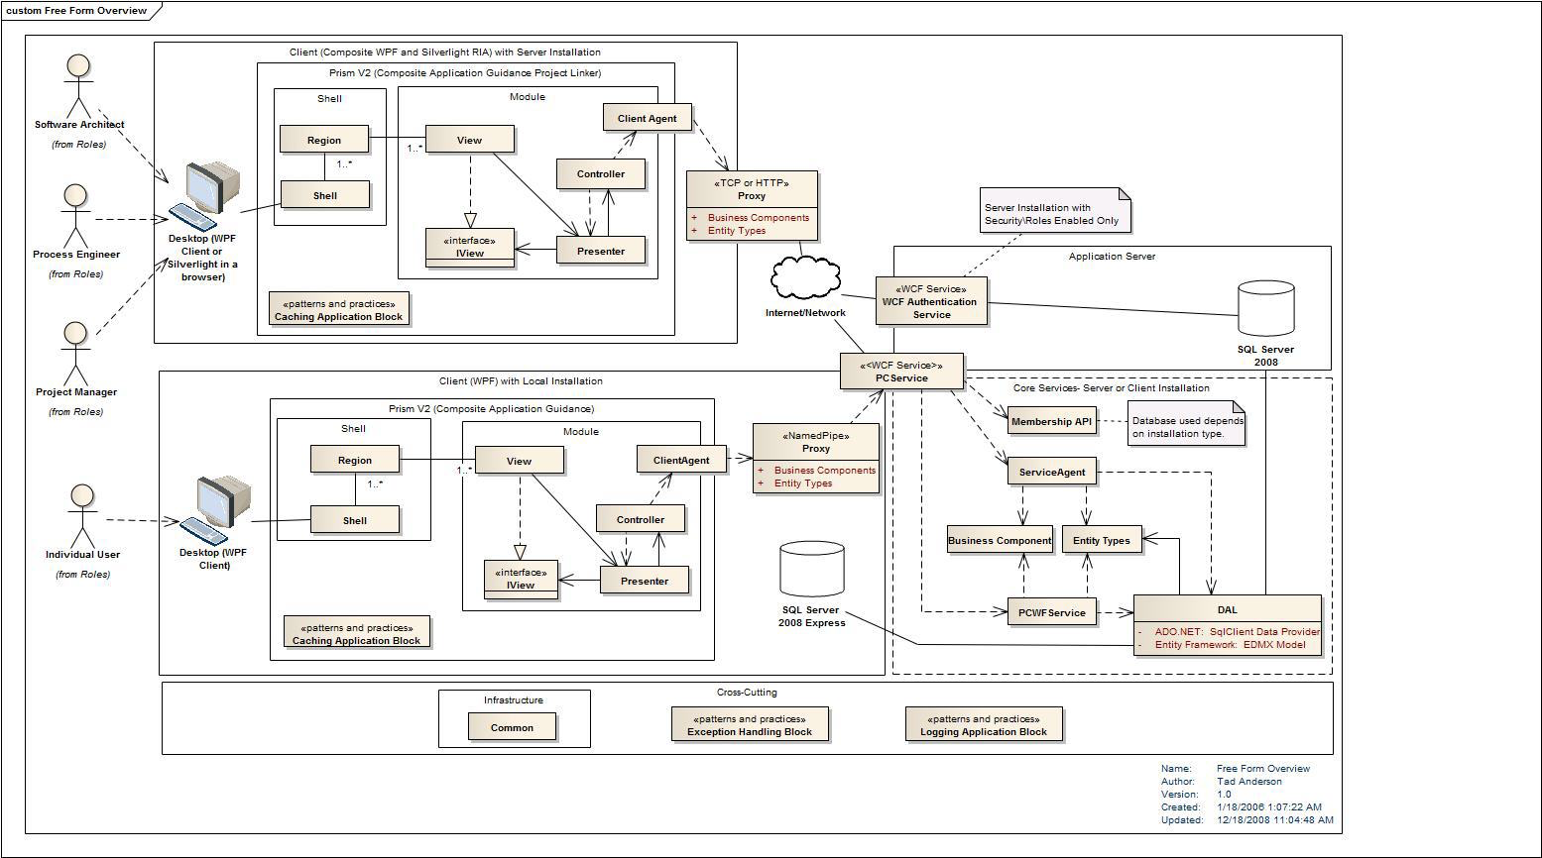

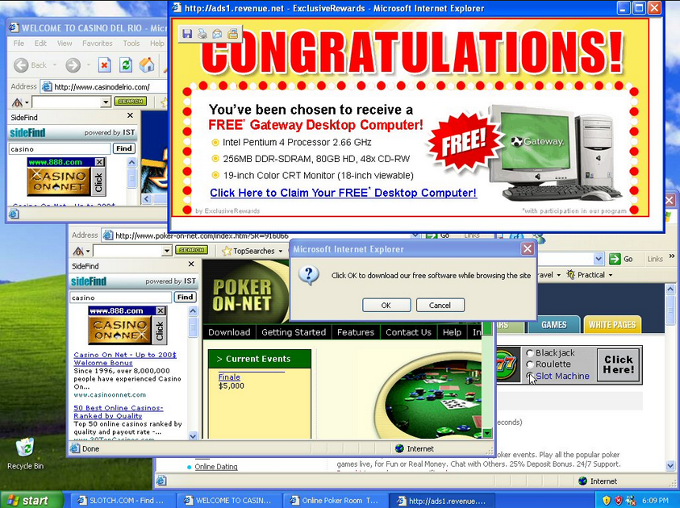
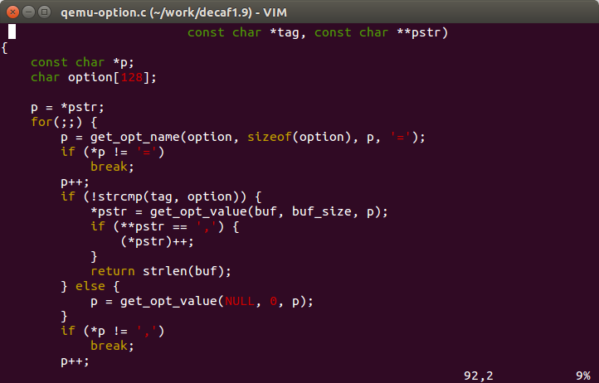
Flaws that would allow an attacker access a system
Hardware Flaws
The attacker just needs oneflaw!!!
Design Flaws
flaw
The Human factor
Bugs in the Program

Slide 6
Program Flaws
In application software
SQL Injection
In system software
Buffers overflows and overreads
Heap: double free, use after free
Integer overflows
Format string
Side Channels Attacks
Cache timing attacks
Power Analysis Attacks
Fault Injection Attacks

Slide 7


Secure Systems Engineering
Approach 1: Design flawless systems
eg. SeL4
(Not easy to develop these systems in a large scale)
Static analysis /
Formal Proof Assistant
eg. COQ

Slide 8

Secure Systems Engineering
Approach 2: Isolate systems : sandbox environments, virtual machines, trusted execution environments (trusted computing)
Takes care of the
human factor as well

Slide 9
Secure Systems Engineering
Approach 3: Detect and Mitigate Attacks

Slide 10
Course Structure
System Software Attacks
Compiler Based Mechanisms
Hardware Based Attacks
Hardware Based
Mechanisms
Side Channel Analysis
Trusted Computing
Environments
Attacks
Defense

Slide 11
What to expect during this course
Deep study of systems:
Software
Assembly level
Compiler and OS level
Hardware
Some computer organization features
Expected Outcomes
Understand the internals of malware and other security threats
Evaluate security measure applied at the hardware, OS, and compiler
Understand trade offs between performance and security

Slide 12
Websites and Communication
Reference Textbooks
mostly research papers; will be provided as per topic
For slides and programming assignments
https://chetrebeiro@bitbucket.org/casl/sse.git

